Slide 1
Weeks 5&6 Exercise
Andrea Fox
January 16, 2021
DSC640 – T301 Data Presentation & Visualization

Slide 2
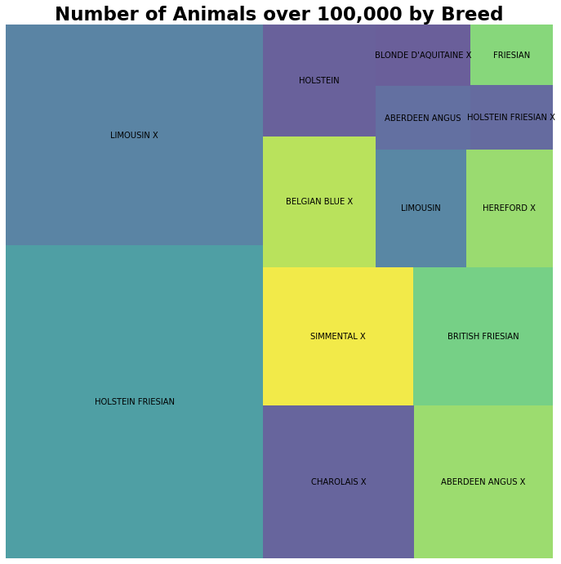
Python - Treemap

Slide 3
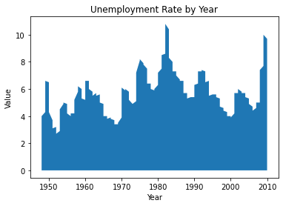
Python – Area Chart

Slide 4
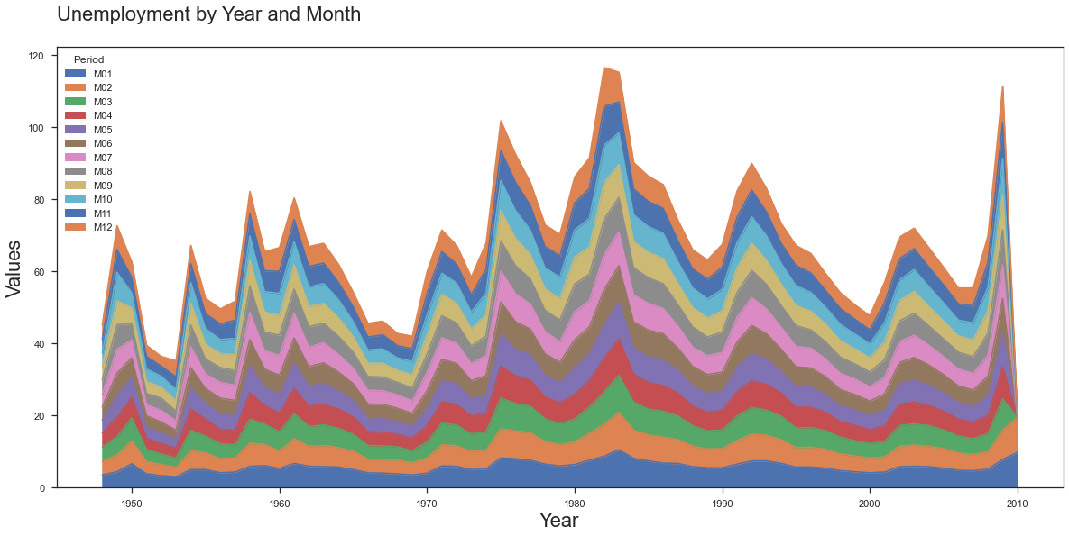
Python – Stacked Area Chart

Slide 5
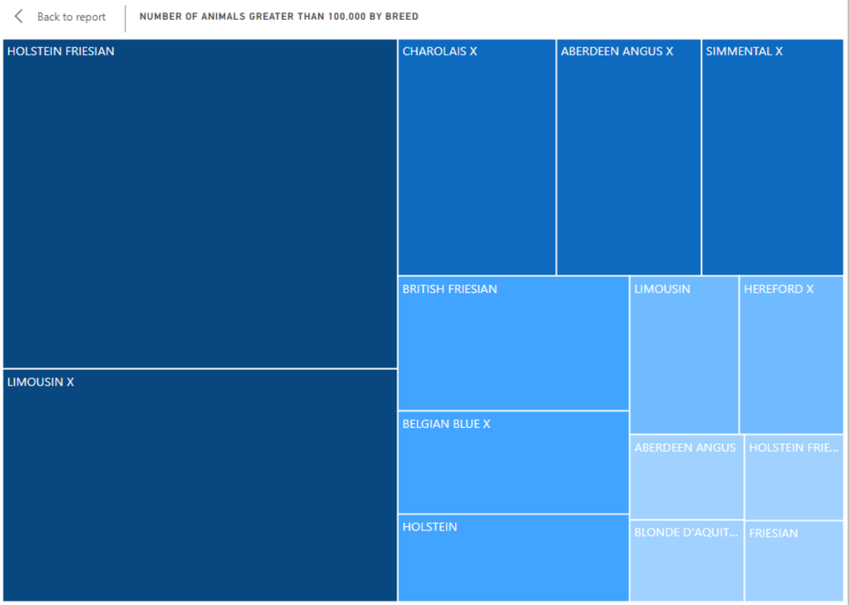
Power BI - Treemap

Slide 6
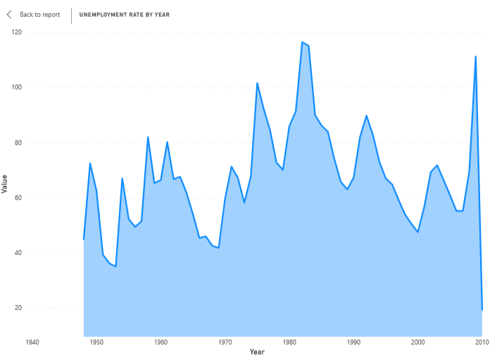
Power BI – Area Chart

Slide 7
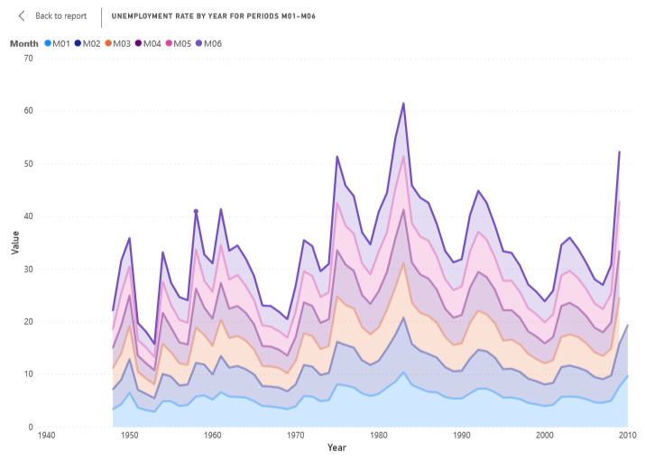
Power BI – Stacked Area Chart

Slide 8
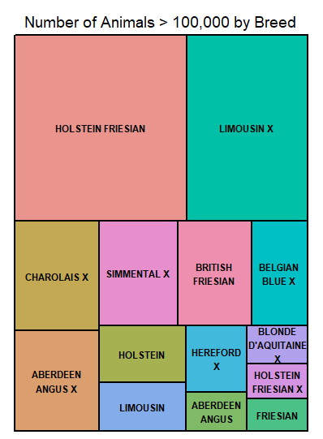
R - Treemap

Slide 9
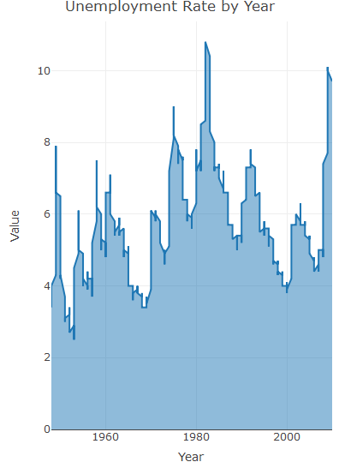
R – Area chart

Slide 10
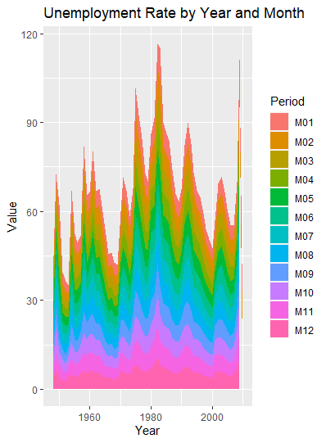
R – Stacked Area Chart

Slide 11
References
Animals Dataset from https://data.gov.uk/dataset/22f2484d-069c-4a08-9fe1-1aeac425af0a/animal-population-by-breed-on-1-march-2010
Unemployment Dataset from zip file for this week’s assignment
Python tree map reference - https://fcpython.com/visualisation/python-treemaps-squarify-matplotlib
Python area chart reference - https://python-graph-gallery.com/240-basic-area-chart/
Python area stacked chart reference - https://python-graph-gallery.com/250-basic-stacked-area-chart/ Also shoutout to Sam Loyd who helped me figure this out as well.
R tree map reference - https://www.r-bloggers.com/2018/09/simple-steps-to-create-treemap-in-r/
R area chart reference - https://plotly.com/r/filled-area-plots/
R stacked area reference - https://www.r-graph-gallery.com/136-stacked-area-chart

